Slide 1
Hospital Management System: A Java Based Application
Prepared by: guided by:
Gursimran singh(032) mr. manish k.bhatia
Gurtek singh(033)
Inderjeet singh(044)
Branch : IT-1

Slide 2
CONTENTS
Aim
Introduction to hospital management system
Requirements
Features of hospital management system
Designing process
Use case diagram
Technologies used
Concepts used
GUI programming
Steps involved and screenshots
Limitations
References

Slide 3
AIM
The main objective of this project is to develop a hospital management system using Java programming language by creating a user friendly GUI framework.
Hospital Information Systems provide a common source of information about a patient’s health history. The system has to keep data in a secure place and controls who can reach the data in certain circumstances. These systems enhance the ability of health care professionals to coordinate care by providing a patient’s health information and visit history at the place and time that it is needed.
The project hospital mangement system is designed to automate the addition,modification and deletion of doctor and patient details. Making less paper work and automate the process of hospital management system.

Slide 4
INTRODUCTION TO HOSPITAL MANGEMENT SYSTEM
A hospital information system (HIS) is an element of health informatics that focuses mainly on the administrational needs of hospitals.
In many implementations, a hospital information system (HIS) is a comprehensive, integrated information system designed to manage all the aspects of a hospital's operation, such as medical, administrative, financial, and legal issues and the corresponding processing of services.

Slide 5
REQUIREMENTS
1.HARDWARE REQUIREMENTS
A computer system with Pentium based systems with a minimum of P4
At least 4 GB RAM.
122 Keys Keyboard
Network Connectivity
2. SOFTWARE REQUIREMENTS
Operating System : WINDOWS 7
Java Development Kit (JDK) 1.7 or above
Java Runtime Environment (JRE)
Java Virtual Machine (JVM)
Integrated Development Environment (IDE) like Eclipse etc.

Slide 6
Features of Hospital Management System
Efficient and accurate administration of finance, diet of patient, engineering, and distribution of medical aid. It helps to view a broad picture of hospital growth
Improved monitoring of drug usage, and study of effectiveness. This leads to the reduction of adverse drug interactions while promoting more appropriate pharmaceutical utilization.
Enhances information integrity, reduces transcription errors, and reduces duplication of information entries.
Hospital software is easy to use and eliminates error caused by handwriting. New technology computer systems give perfect performance to pull up information from server or cloud servers

Slide 7
DESIGNING PROCESS
Front-end designing:
1. It must have a graphical user interface that assists employees that are not from IT background.
2. Scalability and extensibility.
3. Flexibility.
4. Robustness.
5. According to the organization requirement and the culture.
6. Must provide excellent reporting features with good printing support.
7. Platform independent.
8. Easy to debug and maintain.
9. Event driven programming facility.
10. Front end must support some popular back end like Mysql.

Slide 8
Back-end Selection: 1. Multiple user support. 2. Efficient data handling. 3. Provide inherent features for security. 4. Efficient data retrieval and maintenance. 5. Stored procedures. 6. Popularity. 7. Operating System compatible. 8. Easy to install. 9. Various drivers must be available. 10. Easy to implant with the Front-end.

Slide 9
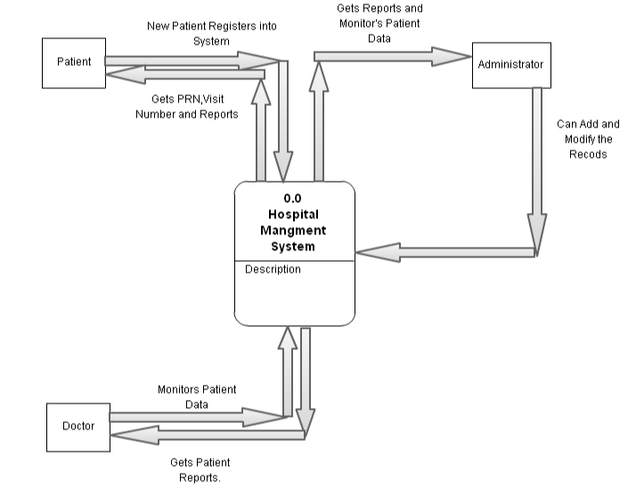
DATA FLOW DIAGRAM
DFD : level 0

Slide 10
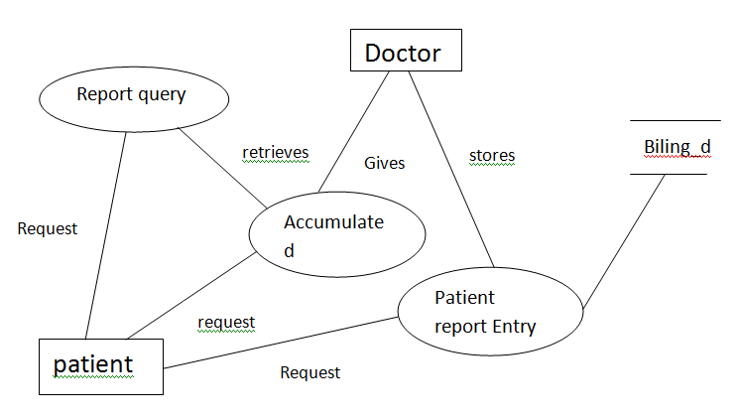
DATA FLOW DIAGRAM
DFD : level 1

Slide 11
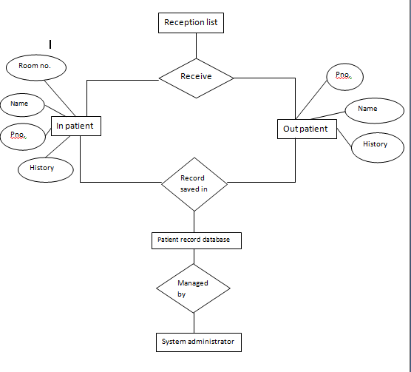
E-R DIAGRAM

Slide 12
TECHNOLOGIES USED
Java technology:
The main technology used in the project is JAVA. Java is a widely used technology used to develop stand-alone desktop applications as well as Web applications.
Some important features of Java are as follows :
Simple
Platform Independent
Secure
Robust
Object oriented

Slide 13
Concepts used
1.Classes and objects
2. Packages
3. Interface
4.String handling
5.Exeption handling
6. Wrapper class
7.Swing for GUI framework
8.JDBC

Slide 14
GUI PROGRAMMING
Create a Jframe using swing class.
Creating buttons, labels and textfields for the GUI.
Write down the actionPerformed for all the components and also create different frame windows on clicking up a button.
Make sure all button are working
Add functionality to each button
Handle abnormal exception on mathematical errors.
Run and execute the program

Slide 15
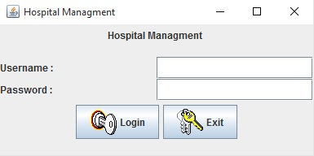
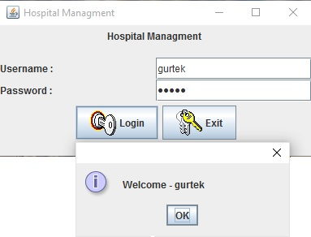
1.User Login

Slide 16
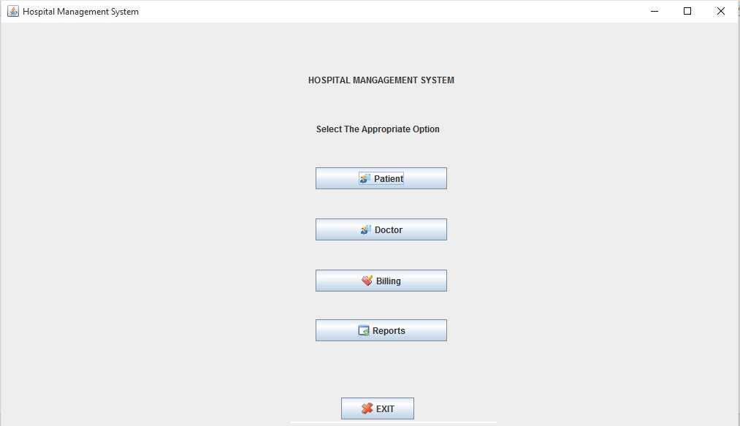
2. All Management Options

Slide 17
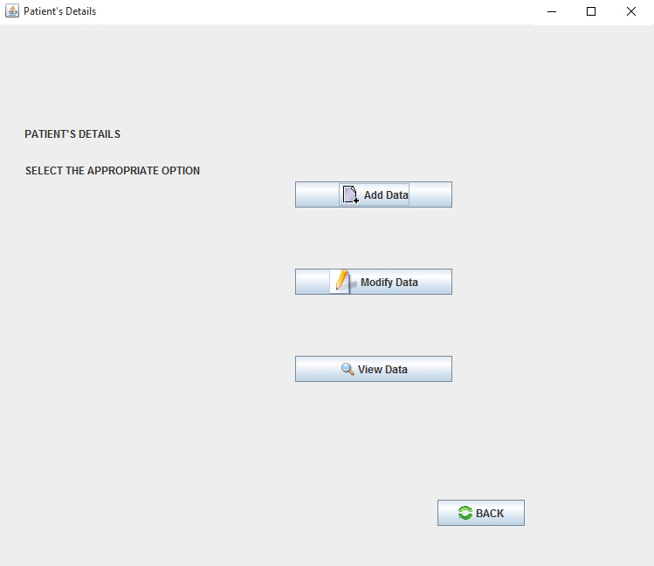
3. To Manage Patient Information

Slide 18
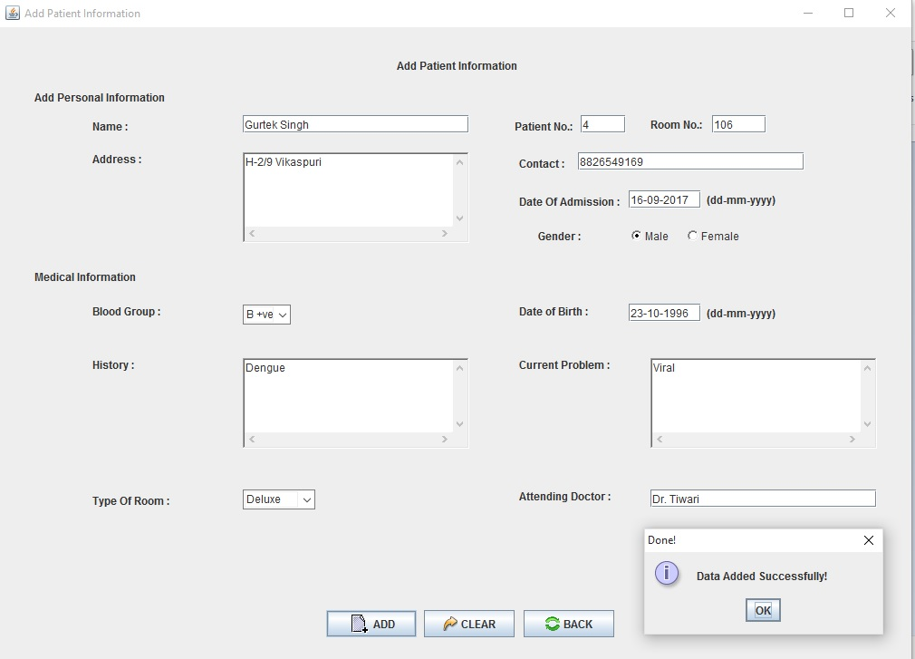
4. Add Paitent Information

Slide 19
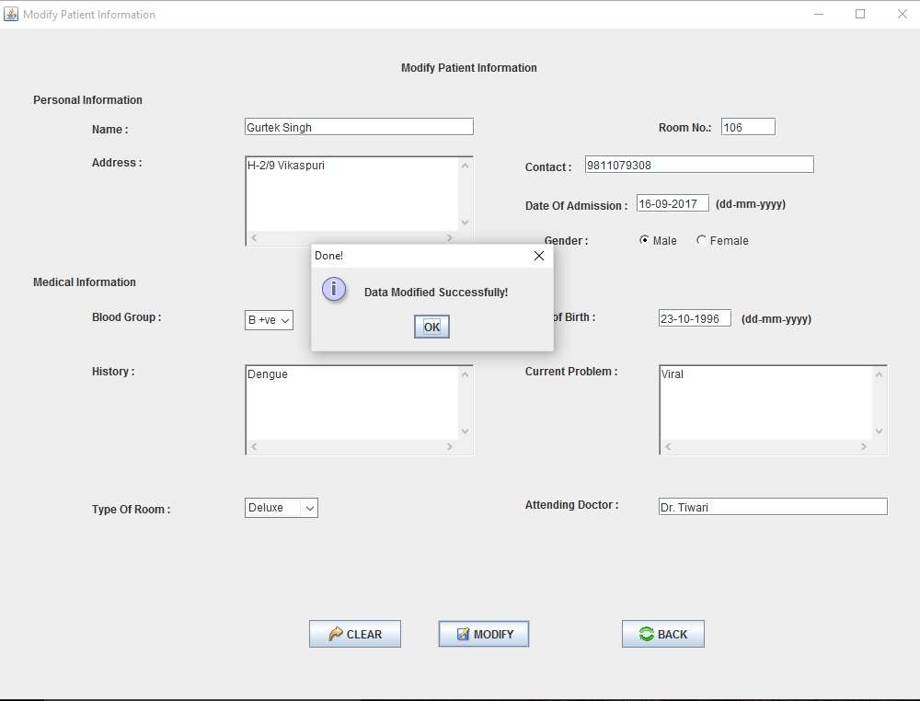
5. To Modify Patient Information

Slide 20
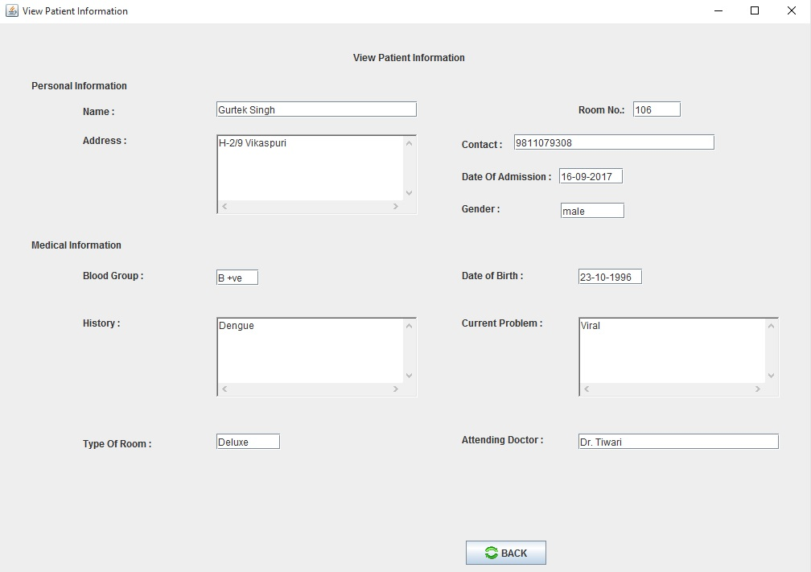
6. To View Patient Information

Slide 21
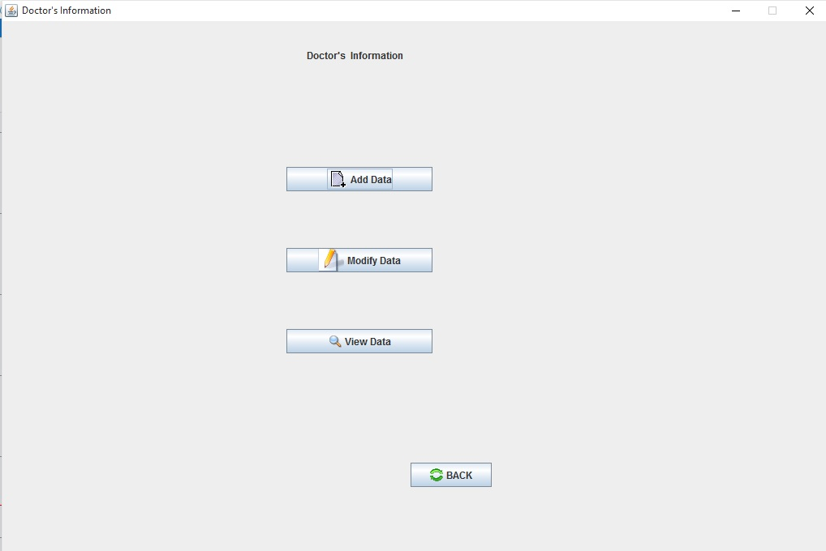
7. To Manage Doctor Information

Slide 22
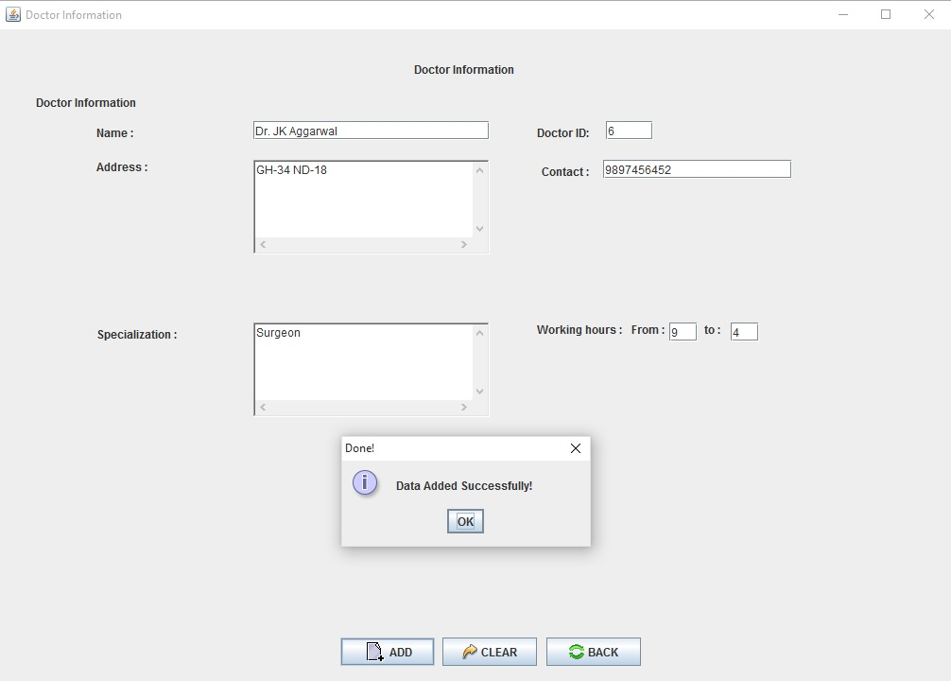
8. To Add Patient Information

Slide 23
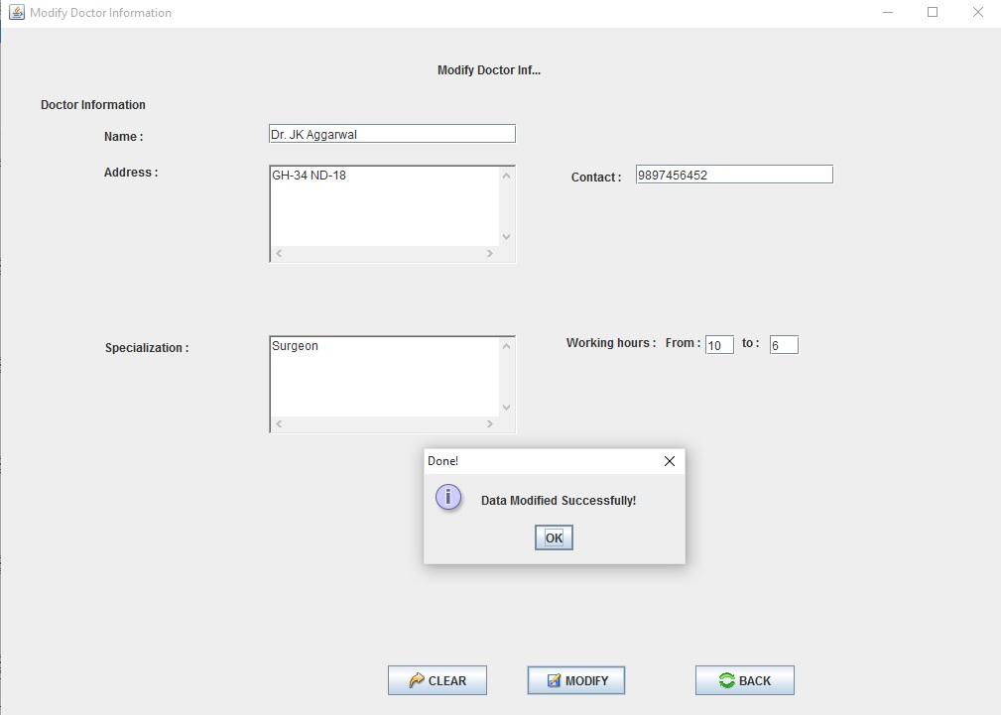
9. To Modify Patient Information

Slide 24
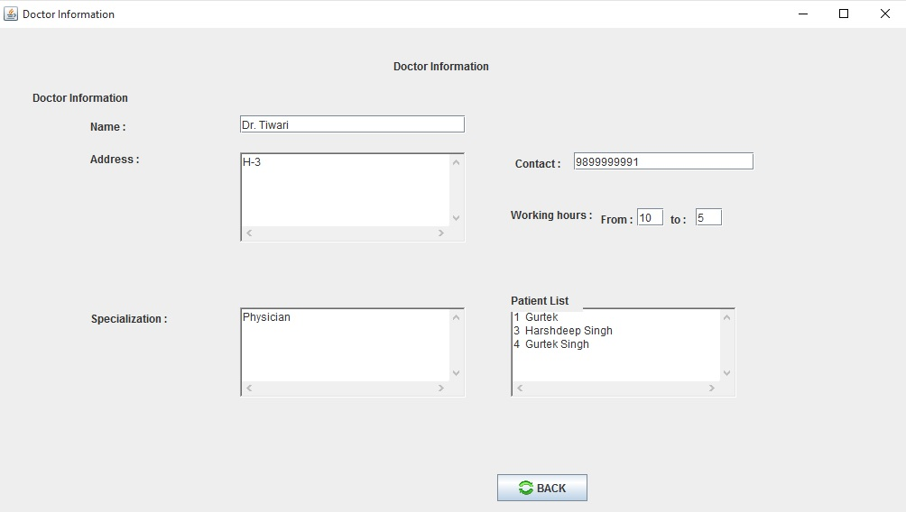
10. To View Patient Information

Slide 25
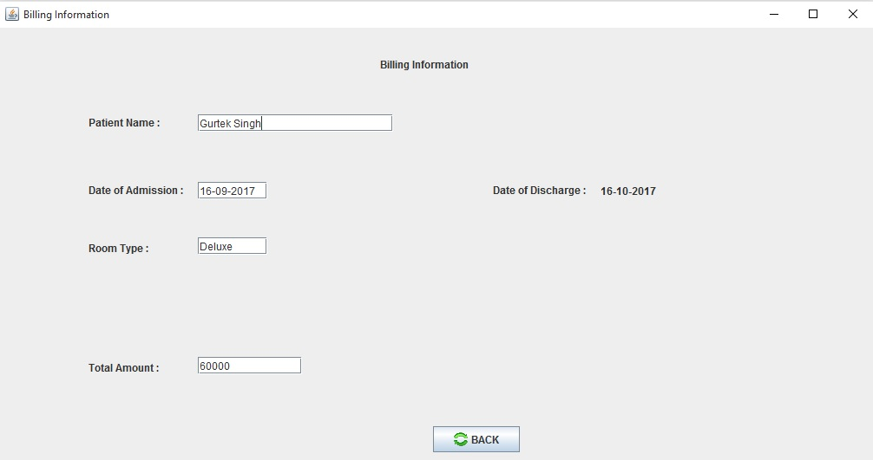
11. To View Patient’s Bill

Slide 26
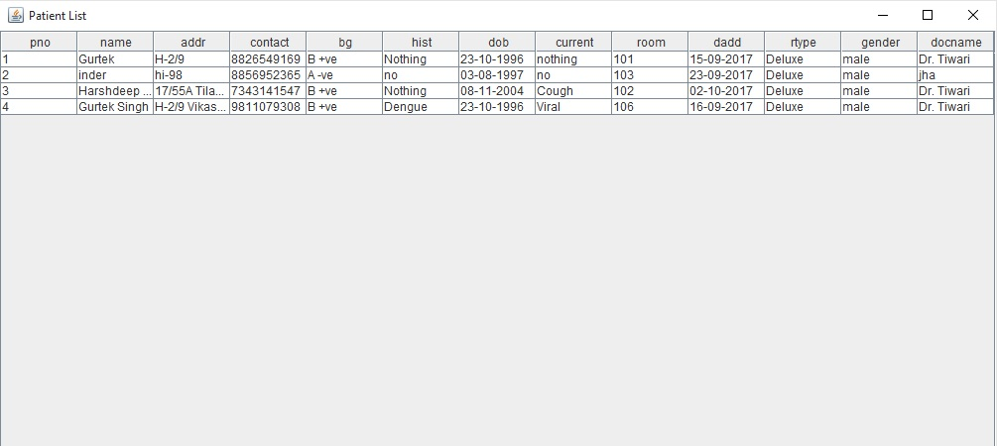
12. To View Patient List

Slide 27
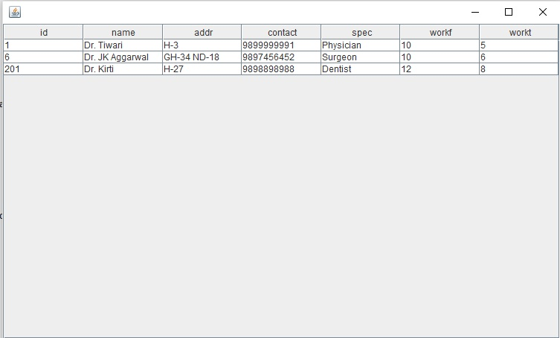
13. To View Doctor List

Slide 28
LIMITATIONS OF THE PROJECT
GUI is only in English.
Login and password is used for identification of user and there is no facility for guest.
Bill cannot be printed.
Report cannot be printed.
Bill is not including the cost of medicines.

Slide 29
REFERENCES
Books
Programming with java – E. Balagurusamy
Java the complete reference- Herbert Schildt
Websites
https://www.scribd.com
https://www.javatpoint.com/java-tutorial
https://stackoverflow.com
https://www.slideshare.net
https://grepcode.com

Slide 30
Thank you

